Slide 1
Kaleidoscope Youth Center
Columbus, OH
Amanda Erickson (she/her/hers)
Education & Training Manager
amanda@kycohio.org

Slide 2
Kaleidoscope Youth Center is the largest and longest serving organization in Ohio solely dedicated to serving and supporting LGBTQIA+ youth.
Our mission is to work in partnership with youth to provide safe and inclusive spaces in our drop-in Center, in schools, and in our community.
Drop-in Center Programming (currently virtual, ages 12-20) includes social connection, current-events discussion, and affinity groups for trans & non-binary youth and QPOC (Queer People of Color).
Our Education & Training Program (currently virtual) provides professional development to schools, youth-serving organizations and others, as well as advocacy for LGBTQ+ youth within the school system.
The KYC Connections Program (ages 16-24) provides case management and housing support to LGBTQ+ young people experiencing housing insecurity.

Slide 3
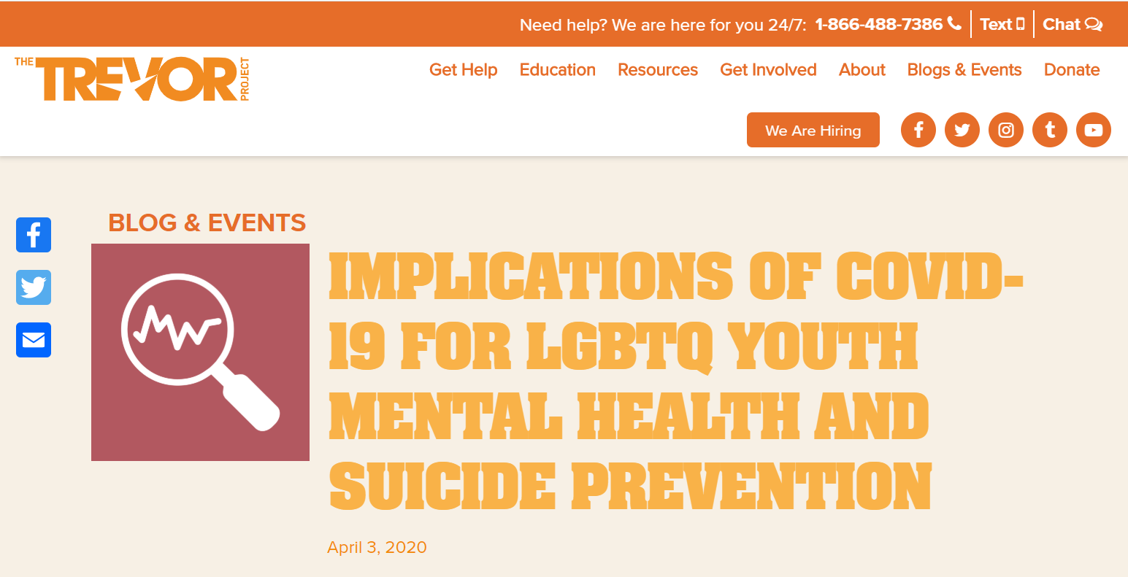
Implications of COVID-19 on LGBTQ+ Youth

Slide 4
Understanding Barriers
The historical and cultural context of sexual rights is one of persistent inequality, especially for queer communities and communities of color.
The history of mental health treatment of LGBTQ+ populations is uneasy.
Prejudice and discrimination have strong negative impacts on the health of young people in general, and our culture reflects ambivalent feelings on rights of minors.
LGB youth are almost five times as likely to have attempted suicide than their heterosexual peers. 54% of trans and non-binary youth reported seriously considering suicide in the past year, and 29% made a suicide attempt*.
Intersectional research on LGBTQ+ youth has been limited, and we must operate under the assumption that multiple intersecting oppressed identities often yield a more negative outcome.
The Trevor Project National Survey Results 2019. New York, New York: The Trevor Project.

Slide 5
Decrease in Positive Social Interactions
As a consequence of stay at home recommendations, LGBTQ youth are potentially losing the social connections that protect them from suicidality.
Existing research has shown that people who are not connected to others are more likely to report depression and anxiety.
Social connections lost include extracurricular activities as a result of schools closing.
The presence of a GSA (Gender & Sexuality Alliance) in a school significantly reduces the risk for depression and increases well-being among LGBTQ+ youth.
The same is true for the presence a race/ethnic club resulting in stronger school belonging in students of color.
Green, A.E., Price-Feeney, M. & Dorison, S.H. (2020). Implications of COVID-19 for LGBTQ Youth Mental Health and Suicide Prevention. New York, New York: The Trevor Project.

Slide 6
Increase in Negative Social Interactions
During the current pandemic, some LGBTQ+ youth are being confined to an environment that may be unsupportive or abusive.
In general, only one third of LGBTQ+ youth report having families who are accepting of their gender and/or sexuality.
One third experience parental rejection.
One third wait until adulthood to come out.
LGB youth who report high levels of parental rejection are eight times more likely to report attempting suicide and six times more likely to report high levels of depression than their peers who experience parental acceptance.
Green, A.E., Price-Feeney, M. & Dorison, S.H. (2020). Implications of COVID-19 for LGBTQ Youth Mental Health and Suicide Prevention. New York, New York: The Trevor Project.

Slide 7
Resiliency Building Factors
LGBTQ+ young people whose parents and caregivers support them show:
Greater well-being
Better general health
Significantly decreased risk for:
Suicide
Depression
Substance abuse
than LGBTQ+ young people whose parents and caregivers reject them.
Research has shown a 29% decrease in suicidal ideation and a 56% decrease in suicidal behavior for each context in which a youth’s chosen name is consistently used, for example at home or at school. (The Trevor Project)
Ryan, C. et al. Family Rejection as a Predictor of Negative Health Outcomes in White and Latino Lesbian, Gay, and Bisexual Young Adults. Pediatrics, January 2009.

Slide 8
Additional Negative Implications
Healthcare:
Due to high rates of discrimination in the healthcare system, and experiences with non-affirming care, LGBTQ+ people experience anxiety about seeking healthcare, up to and including avoiding seeking medical attention, which has disastrous consequences if they are experiencing symptoms of COVID-19.
Economic:
Economic strains caused by losing employment in the service sector lead to increases in housing instability. LGBTQ+ youth already account for 40% of homeless youth.
LGBTQ youth in general may have less ability to rely on family support, which would otherwise provide a buffer against the impact of housing instability.
Green, A.E., Price-Feeney, M. & Dorison, S.H. (2020). Implications of COVID-19 for LGBTQ Youth Mental Health and Suicide Prevention. New York, New York: The Trevor Project.

Slide 9
Reducing Negative Outcomes
Efforts must be made to ensure that LGBTQ youth know they’re not alone, and are empowered to seek support and social connections in creative ways that allow for physical distancing, such as through virtual programming.
Communication regarding COVID-19 must be inclusive of all genders by using gender-neutral language at all times.
Communication regarding COVID-19 must also include young people, not just their parents.
Social media is the main avenue for reaching youth.
Green, A.E., Price-Feeney, M. & Dorison, S.H. (2020). Implications of COVID-19 for LGBTQ Youth Mental Health and Suicide Prevention. New York, New York: The Trevor Project.

Slide 10
Kaleidoscope Youth Center
Columbus, OH
Amanda Erickson (she/her/hers)
Education & Training Manager
amanda@kycohio.org

