Slide 1
Connecting You to a Healthier Life!

Slide 2
Objectives
Why we need to connect and educate
How we connect with people
Who makes the connections

Slide 3
Our Mission
To reduce disparities in health outcomes by eliminating barriers to health and well-being for those in our community.
Notes:
Why does this need to be our mission?
Robust Discussion

Slide 4
What’s the underlying issue?
Poor Health Outcome
Race/Ethnicity
Neighborhood
Social Determinants of Health
Occupation
Culture
Education
Income/Status
Notes:
What we see is only the “tip” of the iceberg or result of more complex and dynamic underlying issues. We have to also consider things like:
neighborhood-when you look at our neighborhoods, which ones are more likely to have higher rates? What do you notice about those neighborhoods?
Race/ethnicity-which groups are more likely to have the highest rates
Occupation-what types or levels of employment are those at greatest risk likely to have?
Culture-how does it play a role in health outcomes and our perception of health and wellness or how we treat those factors?
Education-
Income/status

Slide 5
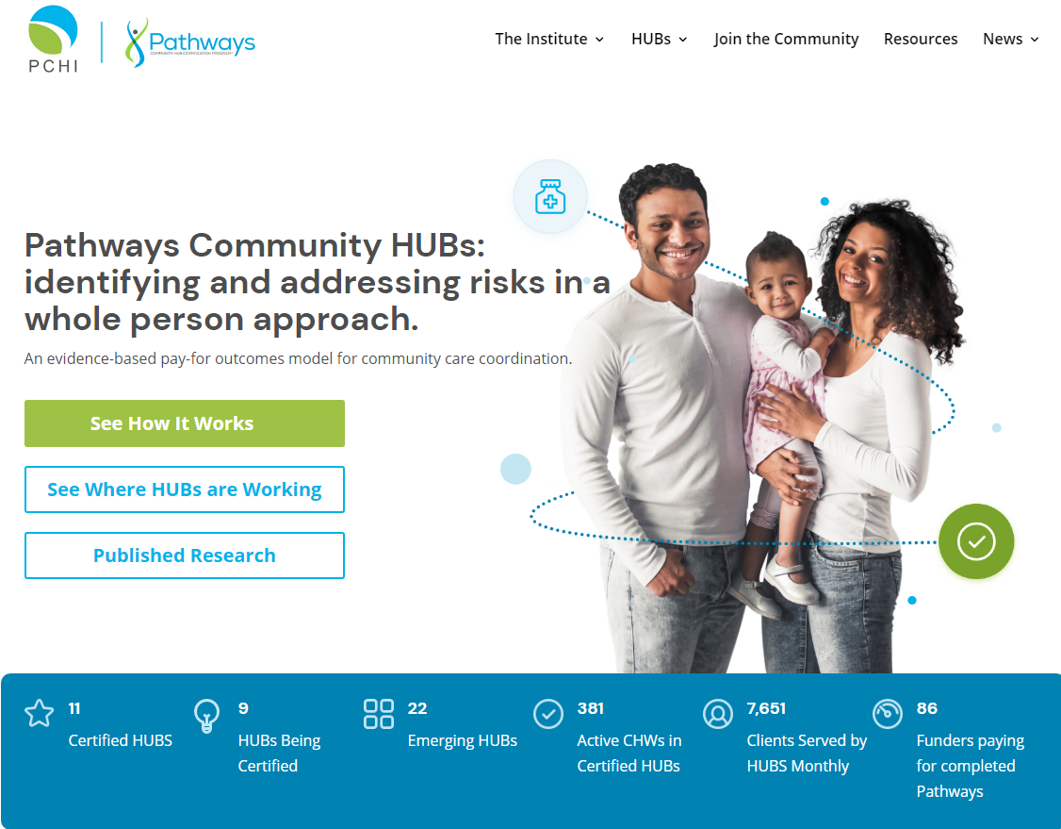
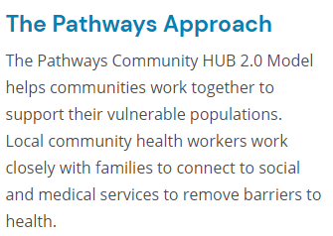
Pathways Community HUB

Slide 6
The Pathways Strategy
FIND
ENGAGE
ASSESS
outreach & enroll
identify
opportunities
track/measure results
Notes:
The model is pretty simple
Find those that are most at-risk. Clients are primarily recruited by the care coordination agencies that HUB contracts with. those agencies employ CHW or home visitors that directly engage the client in here home. There outreach methods may include: canvassing, referrals, etc.
Treat the client’s unique challenges or barriers to positive health outcomes by connecting her to evidence-based and best practice interventions. A large part of what I do is to develop a Network of Care for the HUB and its clients. (explain)
When clients are enrolled into the HUB, the care coordinators completes a comprehensive risk and health assessment with her called an Initial Pregnancy Checklist. The Pathways strategy is then used to address the barrier with the ultimate goal of a positive outcome. (we will look at the strategy more closely in a moment)
Outcomes are measured through data collection and analysis. Care coordinators input client data and information electronically into a system specifically developed for HUBs. The system allows the care coordinators to track the progress of their clients, to implement the pathways strategy when needed at any point during enrollment in the HUB. It also allows the HUB, its funders, community stakeholders, and the legislature to identify gaps in services or resources, so that they can be addressed.

Slide 7
Why focus on the most at risk?
5% of population uses 50% of health care resources
Most at-risk are often the hardest to serve → no incentive to serve them.
Access for all (insured and un-insured) has gotten worse over the past 10 years
Notes:
Title: presenters, lead organization(s), program, message (motto)
7

Slide 8
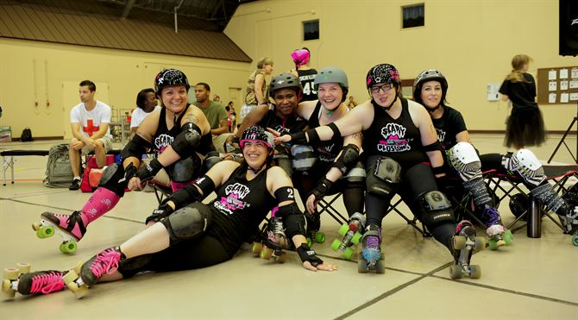
Outreach is a team effort!
Community Health Workers
The HUB
Care Coordination Agencies

Slide 9
What is a CHW?
advocate
assist
support
educate
Notes:
A community representative who advocates for clients in the community
by assisting them in accessing community health and supportive resources
through the provision of such services, education, role modeling, outreach, home visits
and holds a certificate issued by the Ohio Board of Nursing.

Slide 10
What does a CHW do?
how?
outreach
community education
informal counseling
social support
advocacy
builds individual and community capacity
increases health knowledge/self-sufficiency
(American Public Health Association, 2018)
Notes:
CHWs perform numerous roles, including outreach, care coordination, home visiting, informal counseling, social support, health education and promotion and advocacy.
And we also know that CHWs serving in these roles improve health outcomes for our most vulnerable and at risk populations.

Slide 11
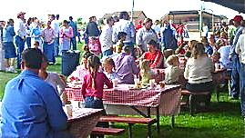
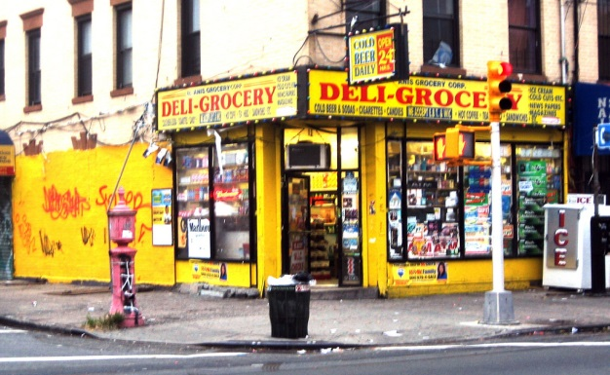
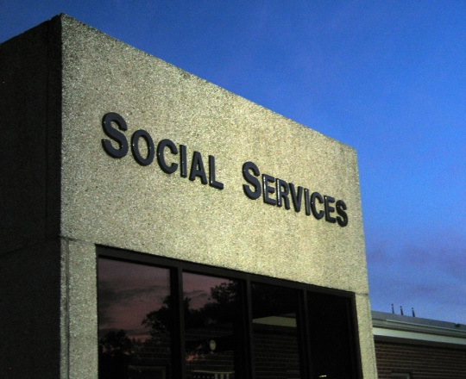
Where?
Notes:
Community events, neighborhoods and businesses, other agencies, healthcare providers, word of mouth
*using your community connections

Slide 12
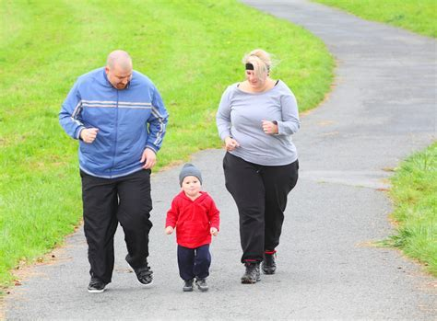
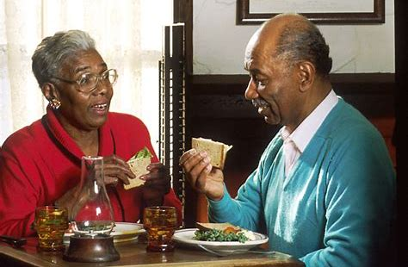
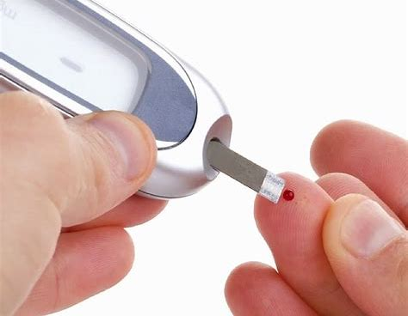
Reducing the risks
… to support healthier lives!

Slide 13
The 20 Standardized Pathways
Adult Learning
Behavioral Health
Developmental Referral
Developmental Screening
Education
Employment
Family Planning
Health Insurance
Housing
Immunization Referral
Immunization Screening
Lead
Medical Home
Medical Referral
Medication Assessment
Medication Management
Postpartum
Pregnancy
Social Service Referral
Tobacco Cessation
Notes:
All Community Pathways HUBs use the 20 standardized Pathways to identify and address risks.

Slide 16
Thank You!
Michelle Edison, MPH, MS
Mahoning Valley Pathways HUB
Mahoning County Public Health
medison@mahoninghealth.org
www.mahoninghealth.org

